Slide 1
Evaluating the Performance of EfficientNet for Synthetic Image Generation in Generative Adversarial Networks
Christopher Anthony Mayes
cmaye001

Slide 2
What is the project about?
Using EfficientNet to generate images in a generative adversarial network.
Notes:
Synthetic image generation with Generative Adversarial Networks has had a huge impact in the development of generative modelling in deep learning. GANs have shown how deep neural networks can be used to create high dimensional, natural looking image samples with features learned from an input distribution. Despite their potential, there are still many concepts that are unexplored or outdated. This thesis aims to aid in the development of such models by researching and evaluating the application of EfficientNet and its uniform model scaling technology, to previous generative tasks to create more efficient, faster image generation models, without forgoing quality.

Slide 3
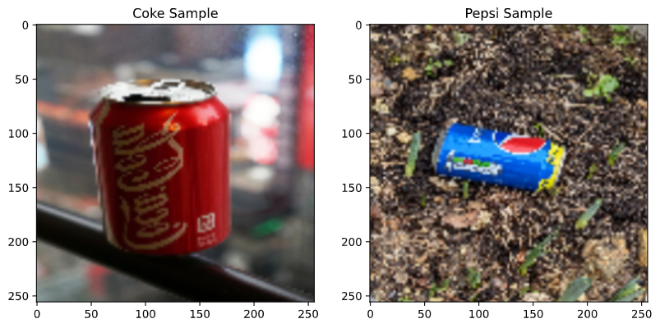
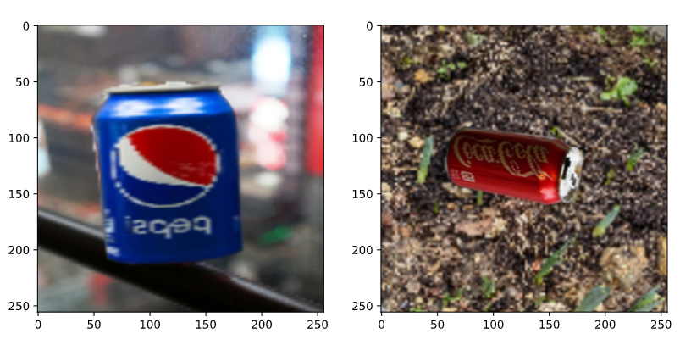
What is the aim of the project?
Deliver a new method of performing image generation that is computationally efficient relative to existing models.
(Simulated translation)
Notes:
The goal of this project is to deliver a new method of performing image generation that is computationally efficient relative to existing models. I aim to produce a model that can accurately translate features between two unpaired data sets using a cycle consistent adversarial network. This network will be written in Python using Tensorflow, and tested against a baseline model that makes use of a Residual Network generator. A generator that uses the EfficientNet architecture will be then be used in place of the residual network and set of these models will be presented, each taking a different approach to the application of EfficientNet. After creating the models, they will be tested on a dataset consisting of Coke and Pepsi can images with the intention of translating one to the other. For example, an image containing a Coke can should become the same image with a Pepsi can in its place. The performance of this translation will be evaluated using multiple metrics that utilise the Mean Absolute Error loss function, comparing both the translation from Pepsi to Coke, as well as the translated Pepsi back to the original Coke image which completes the cyclic aspect of the CycleGAN. In addition, the performance of the network will also be monitored by visually evaluating the image outputs during and after training.

Slide 4
Motivation
Notes:
Generative Adversarial Networks are an outstanding innovation in deep learning and have the potential to produce very impressive results under many use cases. The applications of these networks have been increasing exponentially since their introduction by Goodfellow et al. [9] in 2014. The unlimited real world applications, including healthcare and image restoration, make them an important field to study and develop. A significant downside to these models is the computational costs associated with training when producing high quality outputs. The image generators and discriminators within a Generative Adversarial Network consist of several convolutional layers for down-scaling and feature extraction, transpose convolutions for up-scaling, as well as countless others depending on the given task. This results in a vast number of trainable parameters and therefore very long training times, so investing in expensive hardware becomes essential to mitigate these drawbacks. Conducting research into improving the efficiency of these networks is essential to ensure they can be used when computing power is limited. Until now, the EfficientNet architecture has only been documented on classification problems, and not yet explored for the use of generation, which is why it has become the driving force for this project.

Slide 5
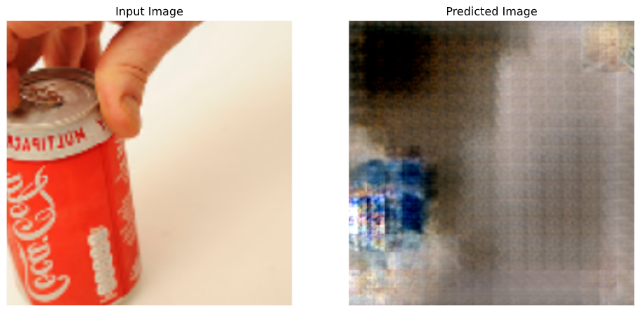
Results – Part 1
Complete EfficientNet model
output
Generator Model | Average Epoch Time (seconds) | Total Training Time (40 epochs) | Trainable Parameters
Residual Network | 67.5 | 45 min 4 sec | 2,800,000
EfficientNet B3 | 130.5 | 1hr 43 min 27 sec | 21,287,998
Notes:
The initial plan was to use the entire pre-trained EfficientNet model in place of the residual generator to utilise its uniform model scaling technology. After running and testing the model for 40 epochs, it was clear that this was not an effective method and there was minimal mapping from the image inputs to the generated outputs.
Due to the significant increase in layers over the residual implementation, the number of trainable parameters is vastly increased. Although this is not ideal, the additional 19 million parameters only result in a 45 second increase per epoch. This highlights that the model scaling technique is functioning as expected, however, the generated outputs are unclear and noisy.

Slide 6
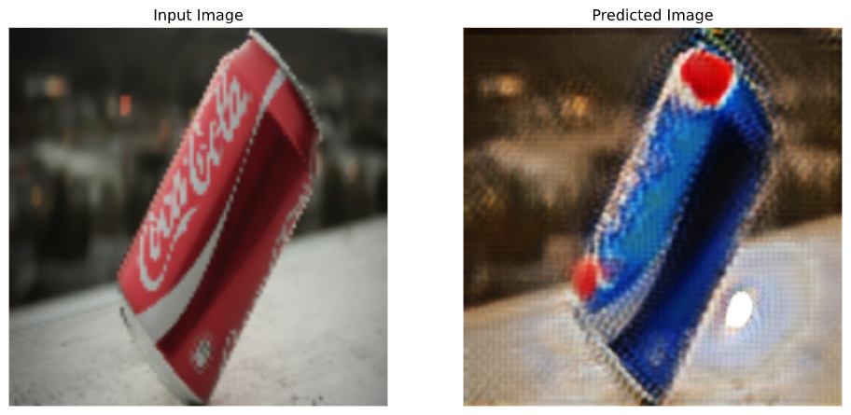
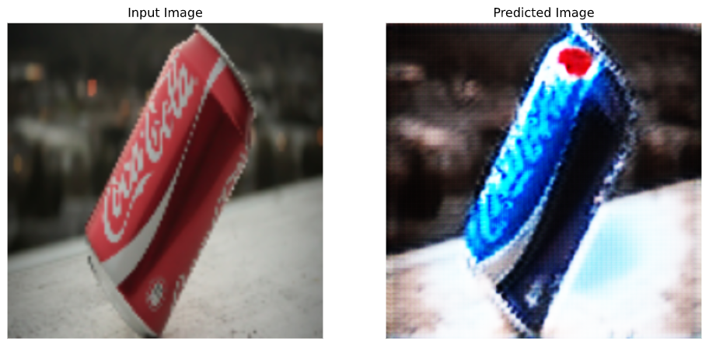
Results – Part 2
Residual Network baseline generator output
Split EfficientNet generator output
Generator Model | Average Epoch Time (seconds) | Total Training Time (40 epochs) | Trainable Parameters
Residual Network | 67.5 | 45 min 4 sec | 2,800,000
EfficientNet B3 | 130.5 | 1hr 43 min 27 sec | 21,287,998
EfficientNet Split | 54 | 36 min 4 sec | 622,305
Notes:
After the initial failure from using the whole EfficientNet model, I was still motivated to discover a functional integration of this technology. Following a review of prior solutions, it became apparent that the encoding and decoding portions of the model are an important element of the generative process. If these are not performed correctly, the network is unable to effectively reconstruct an accurate image output, which is seen in the results from the first test. Knowing this, a new approach to the integration of the EfficientNet model was explored. Merging the up-sampling and down-sampling stages from the baseline, and extracting and stacking blocks of the EfficientNet model for the middle translation stage produced far better results. A centre portion of the EfficientNet model was extracted in order to utilise a smooth down and up-sampling process while retaining the desired efficiency from the model scaling technology. This block consists of 29 layers, each outputting a 64x64 resolution image.
The generated images are far clearer than those from the integration of the entire EfficientNet model. They are comparable to the outputs of the ResNet baseline with both displaying a clear mapping from the inputs to the generated images. The outputs from the trained EfficientNet split are brighter, contain less noise, and have a more accurate identity mapping.
This reduced the number of trainable parameters by 77.8%, bringing the training time for 40 epochs down by 9 minutes.

